Slide 1
Mathematics In Sports

Slide 2
Introduction
Sports analytics, also known as sports data science, applies mathematics to sports.
Mathematical and statistical techniques offer insights into player performance, team strategies, and game dynamics.
Key areas of application include:
Analyzing player statistics
Injury prevention and recovery
Predicting outcomes
Optimizing tactics and game plans
Performance metrics and ratings
Tactical insights and opponent analysis
Advancements in technology and data collection have driven the growth of sports analytics.
Mathematics in sports benefits players, coaches, and fans by enhancing performance and understanding of the game.

Slide 3

Mathematics in
Football

Slide 4
Table of contents
01
02
03
04
Mathematics in
Football
Mathematics in Cricket
Mathematics in Basketball
Conclusion

Slide 5
Football
Player and Team Analysis: Coaches and analysts use mathematical models to analyze player performance and team strategies. They use data on passes, shots, tackles, and other actions during matches to assess individual and team performance, identify strengths and weaknesses, and develop game plans.
Expected Goals (xG): Expected Goals is a statistical metric that uses historical data to estimate the probability of a shot resulting in a goal. It helps evaluate the quality of chances created and taken by a team and individual players.
Optimal Tactics and Formations: Mathematical optimization techniques are employed to find the most effective tactics and formations for a team based on player abilities and opposition strengths.
Player Transfers: When evaluating potential player transfers, clubs use mathematical models to determine the player's value, considering various factors like age, performance, market trends, and the club's financial situation.
Match Predictions: Bookmakers and analysts use mathematical models and statistical algorithms to predict match outcomes and set odds for betting.

Slide 6
Still Football
Video Assisted Refereeing (VAR): VAR technology uses geometric and trigonometric calculations to review decisions, such as offside calls, and help referees make accurate decisions.
Injury Prevention and Analysis: Mathematical models are used to analyze player injury data and design training programs that reduce the risk of injuries.
Fan Engagement: Clubs and leagues use data analytics to understand fan preferences and behavior, enhancing fan engagement and loyalty.
Statistical Analysis: Football statistics, such as goals scored, assists, and pass completion rates, are fundamental to evaluating player and team performances and comparing them across different leagues and seasons.
These are just a few examples of how mathematics is integrated into football. As technology and data analytics continue to advance, mathematics will play an increasingly vital role in shaping various aspects of the sport.

Slide 7
Still Still Football
Expected Goals (xG) Formula:
xG = (Number of Shots on Target) * (Average Probability of Scoring from a Similar Position)
Transfer Valuation Formula:
Player's Value = (Performance Metrics + Age Factor + Market Trends) / (Club's Financial Situation)
Probability Calculation for Match Predictions:
Probability of Team A winning = (Number of previous wins by Team A) / (Total number of previous matches between Team A and Team B)
Statistical Analysis:
Various statistical formulas are used to calculate player and team performance metrics, such as:
Goals per match = (Total goals scored) / (Total matches played)
Assists per match = (Total assists) / (Total matches played)
Pass completion rate = (Number of successful passes) / (Total attempted passes) * 100%
Concepts of Maths: Trigonometry, Statistics, Probability, Linear Programming, Nonlinear Programming, and Integer Programming

Slide 8
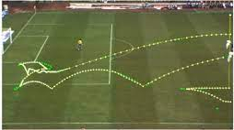
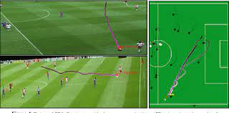
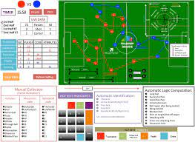
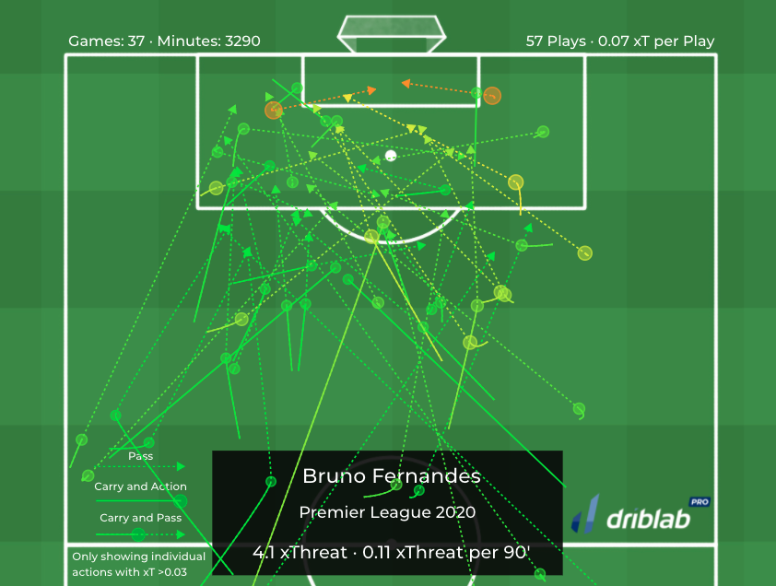

Some Images To Support the Topic

Slide 9
02
Mathematics in Cricket

Slide 10
Cricket
Batting and Bowling Averages: Batting and bowling averages are fundamental statistical measures that quantify a player's performance in terms of runs scored and wickets taken per innings. These averages help assess a player's consistency and impact in the game.
Run Rate: Run rate is the number of runs scored by a team per over. It helps gauge a team's scoring rate and plan their innings accordingly.
Net Run Rate (NRR): In tournament formats, net run rate is used to rank teams based on their run-rate difference between runs scored and runs conceded per over. It becomes significant in tie-breaking scenarios.
Duckworth-Lewis-Stern (DLS) Method: The DLS method is used to adjust targets in rain-affected limited-overs matches. It involves complex mathematical calculations to ensure fairness.
Fielding and Positioning: Captains and coaches use probability and statistical analysis to position fielders strategically based on a batsman's strengths, historical data, and pitch conditions.
Decision Reviews: The Decision Review System (DRS) uses ball-tracking technology and mathematical algorithms to predict the trajectory of the ball and assess LBW (Leg Before Wicket) decisions accurately.

Slide 11
Again Cricket
Optimal Fielding Positions: Fielding captains use mathematical models to determine the best fielding positions for each batsman, based on historical shot data and scoring areas.
Hawk-Eye Technology: Hawk-Eye uses triangulation and mathematical modeling to predict the trajectory of the ball, particularly in tracking LBW and line-call decisions.
Pitch and Weather Analysis: Mathematical models help assess pitch conditions and potential weather impact on a match, guiding teams in their decision-making processes.
Cricket Fantasy Leagues: Fantasy cricket leagues rely heavily on mathematics and statistics to assign values to players and track their performances throughout the season.
Player Selection: Coaches and selectors use statistical analysis to evaluate player performance and determine the best team composition for a match or tournament.
Cricket Scoreboards: The scoring system and how runs are calculated on the scoreboard are based on mathematical principles.
These are some examples of how mathematics is integrated into cricket. The use of data analytics, statistical models, and technology continues to grow in the world of cricket, enhancing performance analysis, decision-making, and overall fan experience.

Slide 12
Again Cricket
1. Batting Average = (Total Runs Scored) / (Number of Innings)
2. Bowling Average = (Total Runs Conceded) / (Number of Wickets Taken)
3. Run Rate = (Total Runs Scored) / (Total Overs Faced)
4. Net Run Rate (NRR) = (Total Runs Scored - Total Runs Conceded) / (Total Overs Faced)
5. Duckworth-Lewis-Stern (DLS) Method:
The DLS method involves a complex set of equations and calculations to adjust targets in rain-affected matches. It takes into account the number of resources (overs and wickets) available to the batting side at the time of the rain interruption.
6. Probability and Statistics in Fielding:
Fielding captains use probability and statistical analysis to position fielders strategically. For example, they might analyze historical data to identify a batsman's scoring areas and adjust field placements accordingly.

Slide 13
Again Cricket
7. Decision Review System (DRS):
The DRS uses ball-tracking technology and mathematical algorithms to predict the trajectory of the ball and assess LBW (Leg Before Wicket) decisions accurately.
8. Hawk-Eye Technology:
Hawk-Eye uses triangulation and mathematical modeling to predict the trajectory of the ball, especially for LBW and line-call decisions.
9. Fantasy Cricket Leagues:
Fantasy cricket leagues use various mathematical formulas to assign values to players and calculate points based on their performances, including runs scored, wickets taken, catches, etc.
10. Player Selection and Performance Analysis:
Coaches and selectors use statistical analysis to evaluate player performance, which includes various averages, strike rates, and other performance metrics.
Concepts of Maths: Averages, Rates, Probabilities, Graphs and Data Visualization, Optimization Techniques, Expected Points, Percentiles, Match Simulations

Slide 14
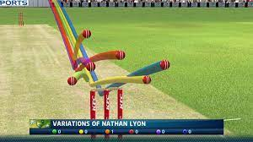
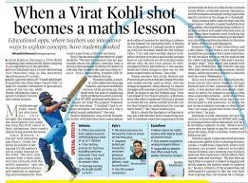

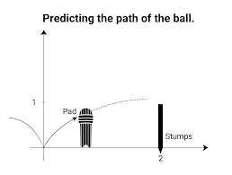
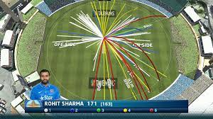
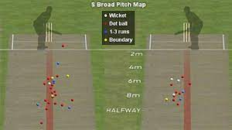
Some Images To Support the Topic

Slide 15

Mathematics in Basketball

Slide 16
Basketball
Shooting Percentages: Field goal percentage (FG%), free-throw percentage (FT%), and three-point percentage (3P%) are essential statistical measures in basketball. These percentages help analyze a player's shooting efficiency and compare performances across different players and teams.
Player Efficiency Rating (PER): PER is a single-number rating that summarizes a player's statistical performance in various aspects of the game, such as scoring, rebounding, assists, and defense. It provides a comprehensive measure of a player's impact on the game.
Advanced Metrics: Advanced statistical metrics like True Shooting Percentage (TS%), Effective Field Goal Percentage (eFG%), and Player Impact Estimate (PIE) take into account the value of different shots and contributions beyond basic box-score statistics.
Probability of Shots: Mathematical models are used to calculate the probability of shots going in from various positions on the court. This helps players and coaches identify high-percentage shooting areas.
Optimal Shot Selection: Coaches and analysts use mathematical analysis to determine shot selection and identify the most efficient shot attempts for each player based on their strengths.

Slide 17
Basketball
Game Strategy and Analytics: Teams use data analytics and mathematical models to analyze opponents' playing styles, strengths, and weaknesses, helping formulate game strategies and defensive plans.
Tracking Player Movements: With player tracking technology, data on player movements, distances covered, and defensive positioning are recorded. Mathematical analysis helps extract insights from this vast amount of data.
Plus-Minus Analysis: Plus-minus statistics track the point differential when a player is on the court. It helps assess a player's impact on the team's performance while they are playing.
Game Simulation: Mathematical simulations are used to predict game outcomes and simulate different scenarios to understand potential strategies.
Salary Cap Management: Teams use mathematical models to manage their salary caps effectively, balancing player salaries and optimizing team compositions within financial constraints.
Sports Betting: In the betting world, mathematical models and statistics are used to set odds for games and predict outcomes.

Slide 18
Basketball
Field Goal Percentage (FG%):
FG% = (Total Field Goals Made) / (Total Field Goals Attempted) * 100%
Free-Throw Percentage (FT%):
FT% = (Total Free Throws Made) / (Total Free Throws Attempted) * 100%
Three-Point Percentage (3P%):
3P% = (Total Three-Pointers Made) / (Total Three-Pointers Attempted) * 100%
Player Efficiency Rating (PER):
PER = (1 / Minutes Played) * (Points Scored + Total Rebounds + Assists + Steals + Blocks - Field Goals Missed - Free Throws Missed - Turnovers)
True Shooting Percentage (TS%):
TS% = (Total Points Scored) / (2 * (Field Goals Attempted + 0.44 * Free Throws Attempted)) * 100%
Effective Field Goal Percentage (eFG%):
eFG% = (Field Goals Made + 0.5 * Three-Pointers Made) / (Field Goals Attempted) * 100%
Player Impact Estimate (PIE):
PIE = (Player's Points + Player's Assists + Player's Rebounds + Player's Steals + Player's Blocks - Player's Field Goals Attempted - Player's Free Throws Attempted - Player's Turnovers) / (Total Team Points + Total Team Assists + Total Team Rebounds + Total Team Steals + Total Team Blocks - Total Team Field Goals Attempted - Total Team Free Throws Attempted - Total Team Turnovers)
Plus-Minus Analysis:
Plus-Minus = (Team's Score While Player is on the Court) - (Opponent's Score While Player is on the Court)

Slide 19
Basketball
Player Impact Estimate (PIE):
PIE = (Player's Points + Player's Assists + Player's Rebounds + Player's Steals + Player's Blocks - Player's Field Goals Attempted - Player's Free Throws Attempted - Player's Turnovers) / (Total Team Points + Total Team Assists + Total Team Rebounds + Total Team Steals + Total Team Blocks - Total Team Field Goals Attempted - Total Team Free Throws Attempted - Total Team Turnovers)
Plus-Minus Analysis:
Plus-Minus = (Team's Score While Player is on the Court) - (Opponent's Score While Player is on the Court)

Slide 20
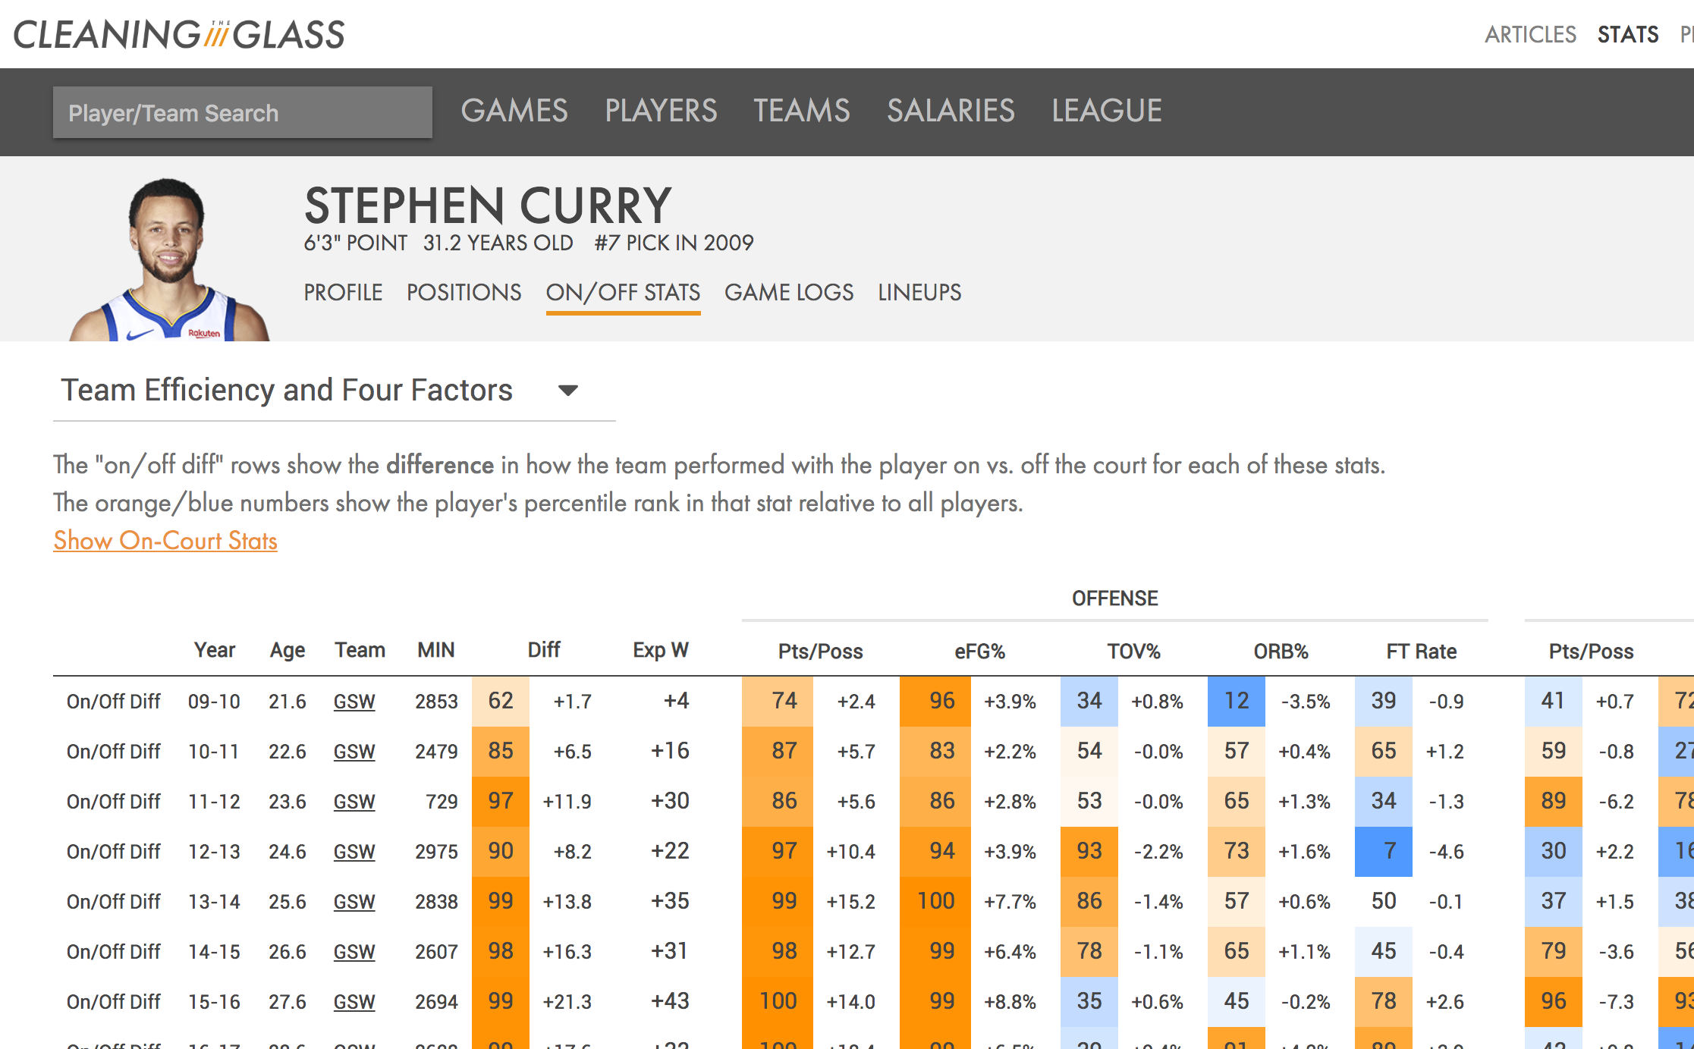
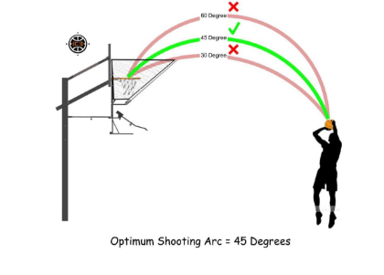
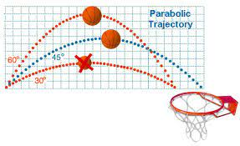
Some Images To Support the Topic

Slide 21
—Sachin Tendulkar
“"Cricket is a game of numbers, and every run counts. Just like in life, every small effort adds up to something significant.”

Slide 22
—Billie Jean King
“"Mathematics is the language of nature, and sports are the expression of life within that language.”

Slide 23
Meet our awesome team
Vaishnavi
Heena.V
Ved.P
Info: Basketball
Info: Basketball
Info: Cricket
Moiz.P
Mansoor.B
PPT,
Info: Cricket
Presentation,
Info: Football

Slide 24
THANK
YOU!

